Slide 1
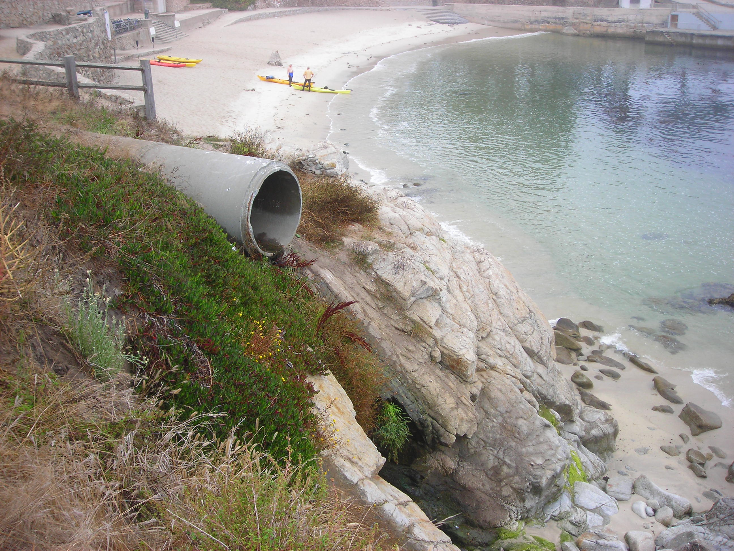
Stormwater outfall watershed delineation, land cover characteristics, and recommended priorities for monitoring and mitigation in the City of Pacific Grove, California
Kathy Pugh
Roger Arenas
Patty Cubanski
Michele Lanctot
AJ Purdy
Ryan Bassett
Jacob Smith
Shaelyn Hession
Kyle Stoner
Gabriela Alberola
Natalie Jacuzzi
Rose Ashbach
Fred Watson
Presentation by CSUMB class ENVS 660 to stormwater management staff from City of Pacific Grove, City of Monterey, Monterey Regional Storm Water Management Program, and Monterey Bay National Marine Sanctuary, 20th Sep 2011.

Slide 2
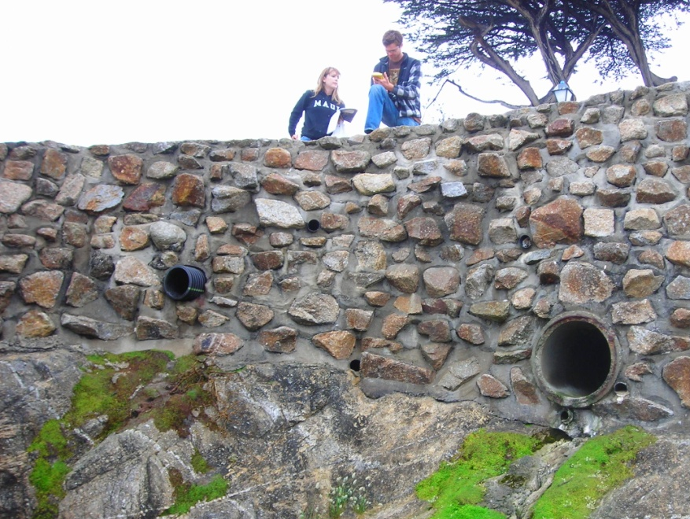
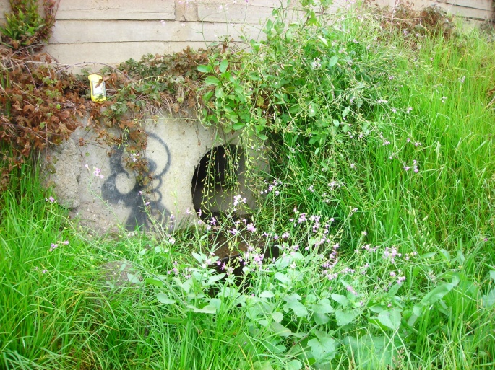
Field Methods
Located outfalls 10” diameter and greater
  Coordinates & measurements recorded
  Photographed
Field validated GIS delineated watersheds

Slide 3
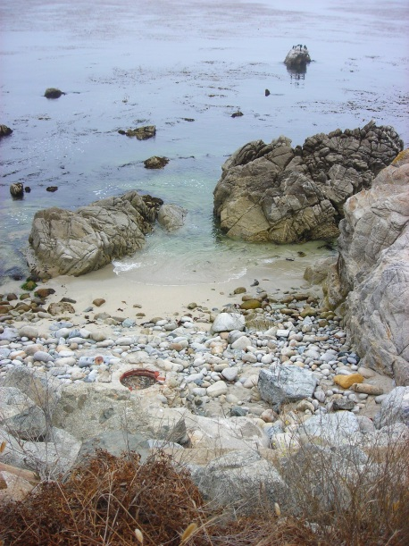
Delineation Methods
Imported storm drain mains data
and Digital Elevation Model
Reclassified storm drain raster to be binary
Subtracted reclassified storm drain raster from the DEM to create “burned” DEM.
Imported storm drain outfall location data
Hydrology Tools within Spatial Analyst
  Fill analysis
  Directional analysis
  Accumulation analysis
  Edited outfalls
  Watershed analysis

Slide 4
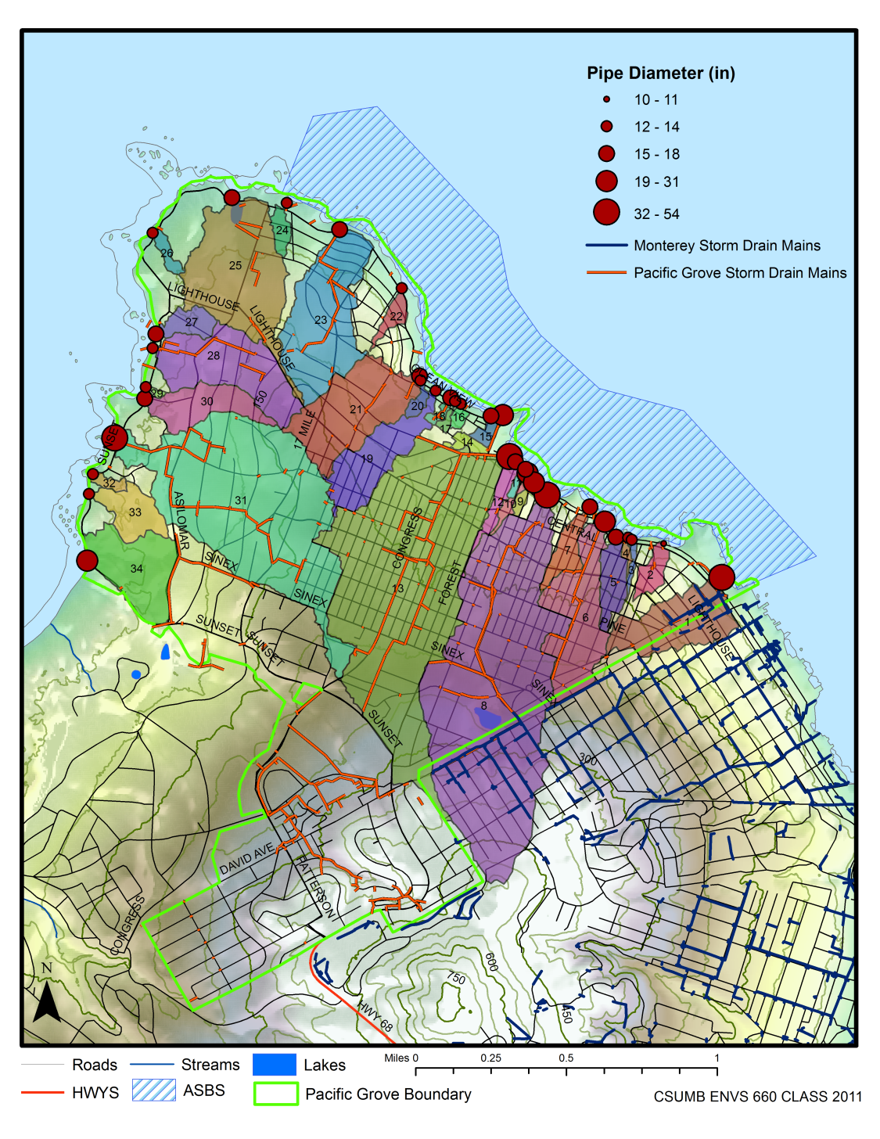
Watershed Boundaries

Slide 5
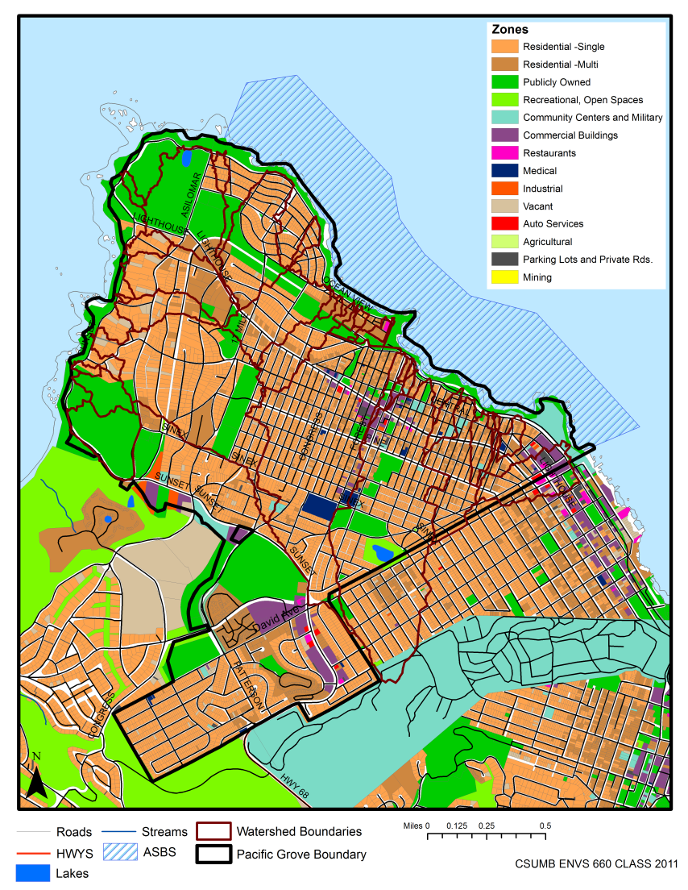
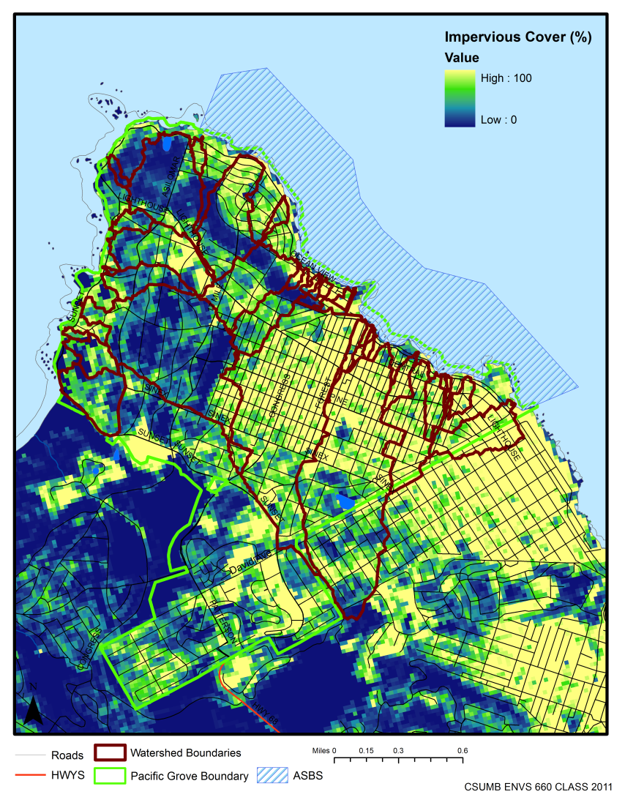
Land Use
Impervious Cover
Land use data source: Monterey County Tax Assessor’s Office and City of Pacific Grove.
Impervious cover data source: USGS, NLCD 2006

Slide 6
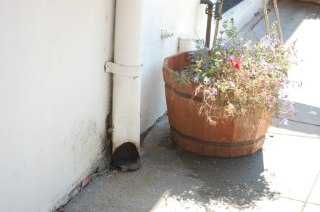
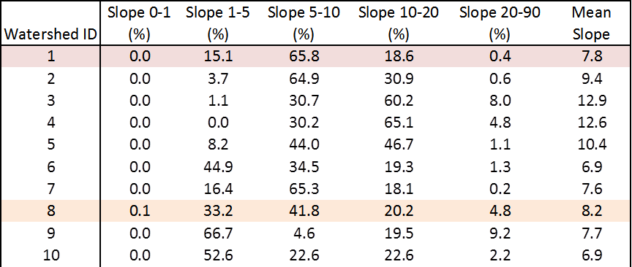
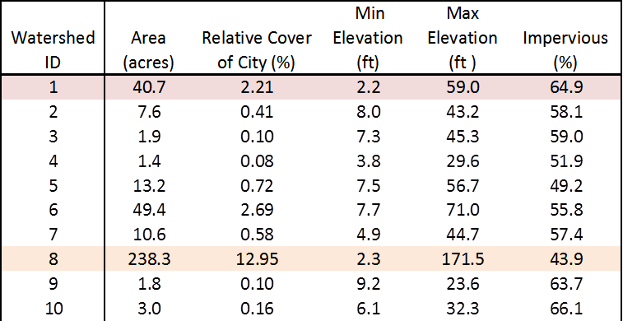
Watershed
Characteristics

Slide 7
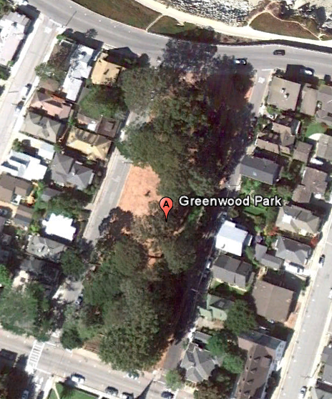

Potential Mitigation
Treatment Wetlands
Stormwater outflow
Treatment Wetland
Detention Pond
Stormwater inflow
Watershed #8, Greenwood Park
Basic Schematic of Wetland System

Slide 8
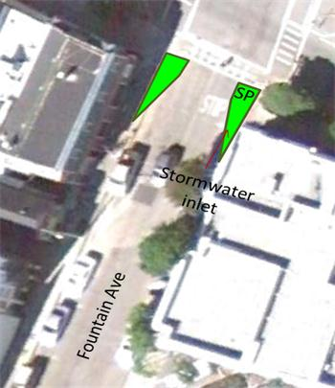
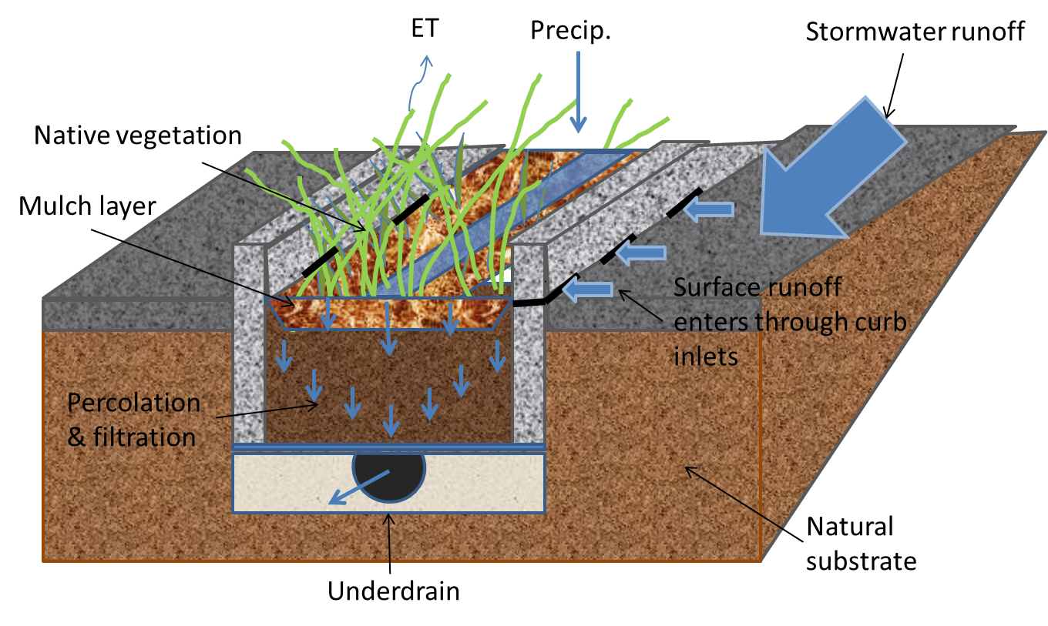
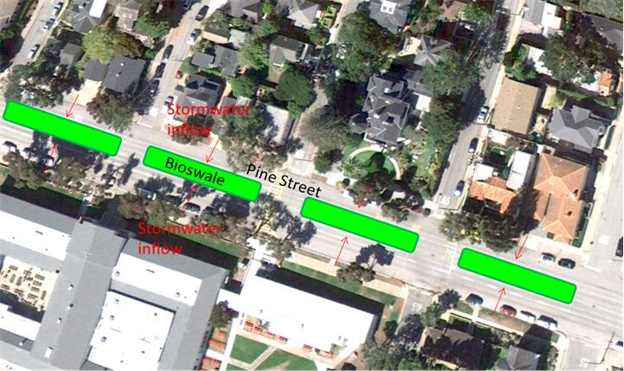
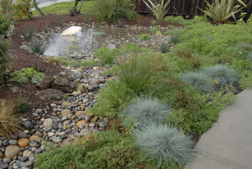
Potential Mitigation
Bioretention
Image courtesy of Ole Christensen

Slide 9
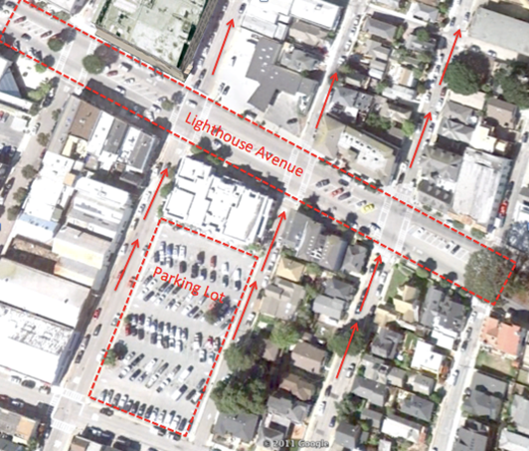

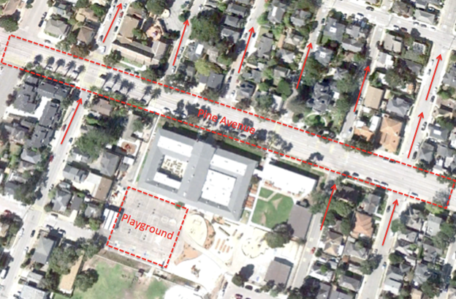

Potential Mitigation
Green concrete alternatives
Direct Rainfall Interception
Surface Runoff Interception
Aggregate Base 1 (1-2”)
GCA 4-8”
Aggregate Base 2 (+6”)
Natural Substrate

Slide 10
Next steps
Prioritize delineated watersheds according to mitigation needs
Collect data necessary for hydrologic modeling
  Precipitation
    local, high-resolution
  Outfall discharge
    Key outfalls
  Soil Characteristics
    Field verification
  Continued water quality monitoring
Build and calibrate watershed model
  Greenwood Park given priority
Assess mitigation measures feasibility using model simulations
  Restructure and reassess mitigation designs if needed
Implement mitigation measures
Continue monitoring

Slide 11
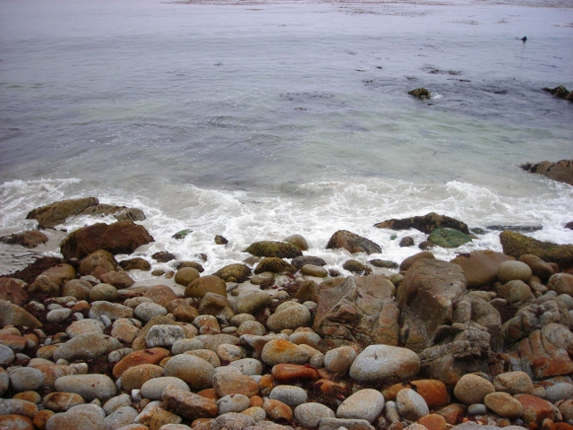
Conclusions/ Questions?

